Slide 1
How do computers represent data?
Mack 2021

Slide 2


How do computers represent data?
When we look at a computer, we see text and images and shapes.
To a computer, all of that is just binary data, 1s and 0s.
The following 1s and 0s represents a tiny GIF:
This next string of 1s and 0s represents a command to add a number:
Notes:
You might be scratching your head at this point. Why do computers represent information in such a hard to read way? And how can 1s and 0s represent so many different things? That's what we'll explore in this lesson.

Slide 3



Slide 4

Bits (binary digits)
Notes:
Computers store information using bits. A bit (short for "binary digit") stores either the value 0, or 1

Slide 5
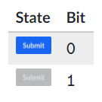
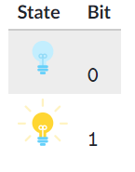
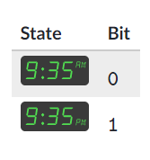

What fits in a bit?
A single bit can only represent two different values. That's not very much, but that's still enough to represent any two-valued state.
Is a lightbulb on or off?
Is a button enabled or disabled?
Is the current time AM or PM?

Slide 6
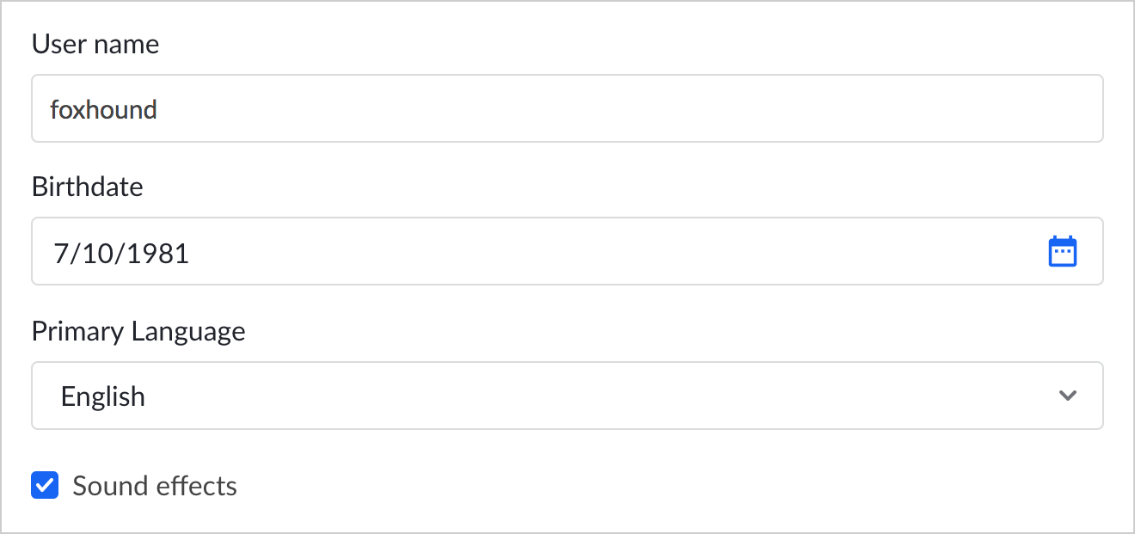

CHECK YOUR UNDERSTANDING
Consider this settings screen for a user information:
Which of the settings can be stored in a single bit?
Notes:
🍐 This is a Pear Deck Multiple Choice Slide. Your current options are: A: User name, B: Birthdate, C: Primary language, D: Sound effects,
🍐 To edit the type of question or choices, go back to the "Ask Students a Question" in the Pear Deck sidebar.

Slide 7


Sequences of bits
Computers use multiple bits to represent data that is more complex than a simple on/off value.
A sequence of two bits can represent four (2^2) distinct values:
A sequence of three bits can represent eight (2^3) different values:
Notes:
A sequence can represent many things: a number, a character, a pixel. Plus, the same sequence can represent different types of data in different contexts. The sequence 1000011 could represent 67 in a calculator application while also representing the letter "C" in a text file.

Slide 8
CHECK YOUR UNDERSTANDING
How many different values can four bits represent?
Notes:
🍐 This is a Pear Deck Text Slide
🍐 To edit the type of question, go back to the "Ask Students a Question" in the Pear Deck sidebar.

Slide 9
Physical storage
Computers typically store bits using electromechanical transistors which can map electrical signals to either an on or off state.
Do you have any questions about this topic?
Notes:
🍐 This is a Pear Deck Text Slide
🍐 To edit the type of question, go back to the "Ask Students a Question" in the Pear Deck sidebar.

Slide 10


Slide 11
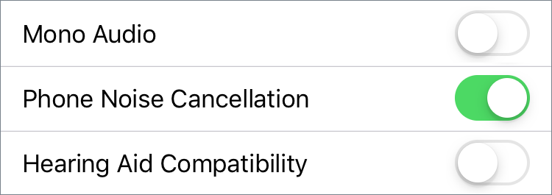
The Apple iPhone includes a settings menu where you can toggle various accessibility options on or off:
What is the minimum number of bits that can represent those 3 options?
Notes:
🍐 This is a Pear Deck Text Slide
🍐 To edit the type of question, go back to the "Ask Students a Question" in the Pear Deck sidebar.

Slide 12
Which of these values can be stored in a single bit?
Notes:
🍐 This is a Pear Deck Multiple Choice Slide. Your current options are: A: 4, B: 0, C: [0, 1, 0], D: 11,
🍐 To edit the type of question or choices, go back to the "Ask Students a Question" in the Pear Deck sidebar.

Slide 13
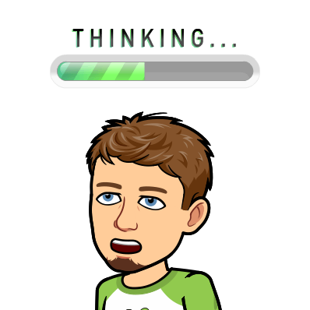
Which of these best describe what a binary digit can store?
Notes:
🍐 This is a Pear Deck Multiple Choice Slide. Your current options are: A: A binary digit can store a series of two single-digit values, such as [4, 8]., B: A binary digit can store one of the values from 0 - 9., C: A binary digit can store one of two values, 0 or 1., D: A binary digit can store a series of two 0/1 values, such as [1, 1].,
🍐 To edit the type of question or choices, go back to the "Ask Students a Question" in the Pear Deck sidebar.

Slide 14

An Apple Mac computer includes a status menu with various indicators:
Which of the indicators could represent a single bit of information?
👁️Note that there are 2 answers to this question.

Slide 15


Slide 16
Bytes
A bit is the smallest piece of information in a computer, a single value storing either, 0 or 1.
A byte is a unit of digital information that consists of 8 of those bits.
Here's a single byte of information:
11110110
Here are three more bytes of information:
000010100101010011011011

Slide 17
From bits to bytes
Conversion between bits and bytes is a simple calculation: divide by 8 to convert from bits to bytes or multiply by 8 to convert from bytes to bits. Try it yourself!

Slide 18

CHECK YOUR UNDERSTANDING
How many bytes long is this binary sequence?
1011100111011011011010010011010101111111
Notes:
🍐 This is a Pear Deck Text Slide
🍐 To edit the type of question, go back to the "Ask Students a Question" in the Pear Deck sidebar.

Slide 19
CHECK YOUR UNDERSTANDING
How many bits are in 888 bytes of information?
Notes:
🍐 This is a Pear Deck Text Slide
🍐 To edit the type of question, go back to the "Ask Students a Question" in the Pear Deck sidebar.

Slide 20
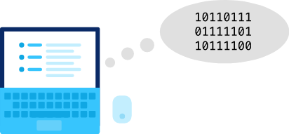
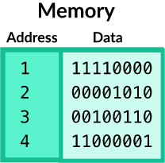
Why bytes?
What is so special about 888 bits that it deserves its own name?
Computers do process all data as bits, but they prefer to process bits in byte-sized groupings. Or to put it another way: a byte is how much a computer likes to "bite" at once.
The byte is also the smallest addressable unit of memory in most modern computers. A computer with byte-addressable memory can not store an individual piece of data that is smaller than a byte.

Slide 21
What's in a byte?
A byte represents different types of information depending on the context. It might represent a number, a letter, or a program instruction. It might even represent part of an audio recording or a pixel in an image.
We'll explore how computers can use bits and bytes to represent all types of information in this unit.

Slide 22
Questions
Do you have any questions about this topic?
Notes:
🍐 This is a Pear Deck Text Slide
🍐 To edit the type of question, go back to the "Ask Students a Question" in the Pear Deck sidebar.

Slide 23
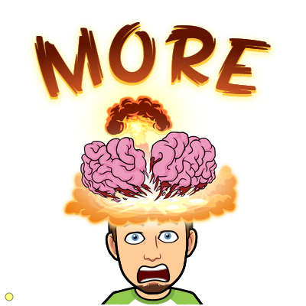
Practice

Slide 24
Consider this sequence of bits:
1011001010010010
How many bytes long is that sequence of bits?
Notes:
🍐 This is a Pear Deck Multiple Choice Slide. Your current options are: A: 2, B: 8, C: 16, D: 4,
🍐 To edit the type of question or choices, go back to the "Ask Students a Question" in the Pear Deck sidebar.

Slide 25
How many bits are in 4 bytes?
Notes:
🍐 This is a Pear Deck Multiple Choice Slide. Your current options are: A: 8, B: 24, C: 32, D: 48,
🍐 To edit the type of question or choices, go back to the "Ask Students a Question" in the Pear Deck sidebar.

Slide 26
When writing binary data, we often put a space between each byte to make it easier for humans to read.
Consider this binary data:
1011011010110001
Which option puts a space after each byte?
Notes:
🍐 This is a Pear Deck Multiple Choice Slide. Your current options are: A: 1 0 1 1 0 1 1 0 1 0 1 1 0 0 0 1, B: 1011 0110 1011 0001, C: 10 11 01 10 10 11 00 01, D: 10110110 10110001,
🍐 To edit the type of question or choices, go back to the "Ask Students a Question" in the Pear Deck sidebar.

Slide 27
Which of the following is a single byte of digital information?
Each choice is expressed in binary.
Notes:
🍐 This is a Pear Deck Multiple Choice Slide. Your current options are: A: 0110, B: 11010010, C: 111011011, D: 101101, E: 1,
🍐 To edit the type of question or choices, go back to the "Ask Students a Question" in the Pear Deck sidebar.

Slide 28



Draw or type 2 things you learned in today’s lesson:
Notes:
Lessons Learned
Use this template to help students articulate and retain their two most memorable takeaways from the day.
🍐 This is a Pear Deck Drawing Slide
🍐 To edit the type of question, go back to the "Ask Students a Question" in the Pear Deck sidebar.

